Slide 1
Structural Implementation using VERILOG

Slide 2
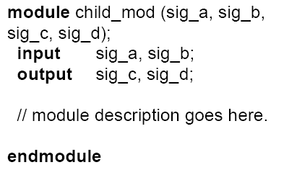
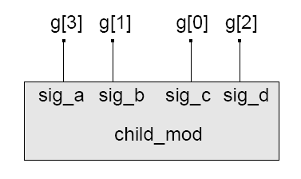
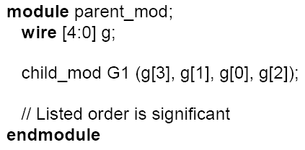
Type of Port Connections
Connection by Position
parent_mod

Slide 3
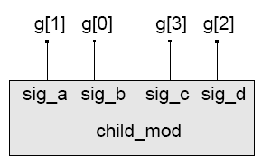
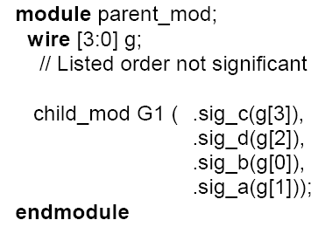
Type of Port Connections (cont.)
Connection by Name
parent_mod

Slide 4
Empty Port Connections
If an input port of an instantiated module is empty, the port is set to a value of z (high impedance).
module child_mod(In1, In2, Out1, Out2) module parent_mod(…….)
input In1;
input In2; child_mod mod(A, ,Y1, Y2);
output Out1; //Empty Input
output Out2; endmodule
//behavior relating In1 and In2 to Out1
endmodule
If an output port of an instantiated module is left empty, the port is considered to be unused.
module parent_mod(…….)
child_mod mod(A, B, Y1, ); //Empty Output
endmodule

Slide 5
Example – 1 : Implement Full adder By structural approach
x
sum
y
Full Adder
cout
cin

Slide 6

Inside the Black box
a
t1
sum
x
s
s
HA1
a
b
c
y
HA2
t3
c
Full Adder
t2
b
cout
cin

Slide 7
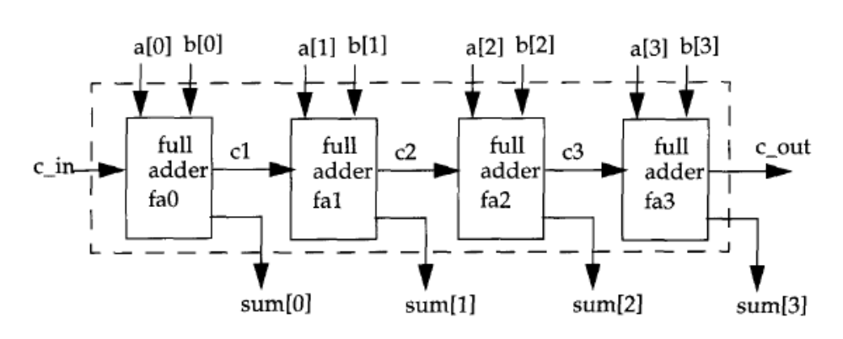
4 bit adder using 1 bit adder

Slide 8
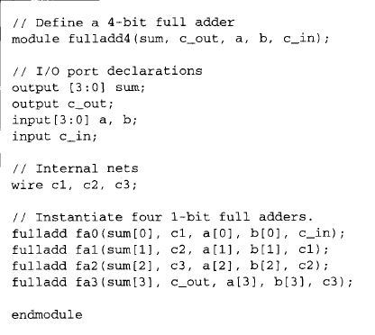

Slide 9
Example 2 – Counter with clock selector
reset
Clk0
Clk1
mux
counter
count
Clk2
Clk3
cs1
cs0

Slide 10
Test Bench
`timescale 1ns/100ps
module Top;
reg PA, PB;
wire PSum, PCarry;
HalfAdder G1(PA, PB, PSum, PCarry);
initial begin: LABEL
reg [2:0] i;
for (i=0; i<4; i=i+1) begin
{PA, PB} = i;
#5 $display (“PA=%b PB=%b PSum=%b PCarry=%b”, PA, PB, PSum, PCarry);
end // for
end // initial
endmodule
Test Bench
Apply Inputs
Design
Module
Observe Outputs

Slide 11
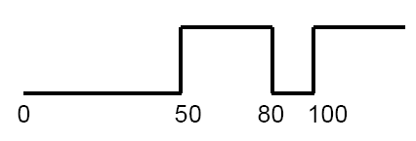
Test Bench - Generating Stimulus
Example: A sequence of values
  initial begin
  Clock = 0;
  #50 Clock = 1;
  #30 Clock = 0;
  #20 Clock = 1;
  end

Slide 12
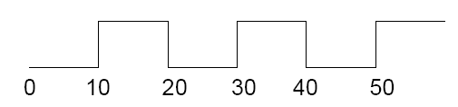
Test Bench - Generating Clock
Repetitive Signals (clock)
Clock
A Simple Solution:
  wire Clock;
  assign #10 Clock = ~ Clock
Caution:
  Initial value of Clock (wire data type) = z
  ~z = x and ~x = x

Slide 13
Test Bench - Generating Clock (cont.)
Initialize the Clock signal
    initial begin
    Clock = 0;
    end
Caution: Clock is of data type wire, cannot be used in an initial statement
Solution:
    reg Clock;
    …
    initial begin
    Clock = 0;
    end
    …
    always begin
    #10 Clock = ~ Clock;
    end
forever loop can
also be used to
generate clock

